Slide 1
Docker
WWW.DTHINKS.IT
INFO@DTHINKS.IT
Digital Thinks S.r.l.
P.zza Indro Montanelli, 20 - 20099 Sesto San Giovanni (MI) - +39 028721132

Slide 2





Chi sono
Antonio Liccardi
Chief Technology Officer @ Blexin
Microsoft MVP for Developer Technologies
Founder DotNetCampania
Trainer / Speaker / Blogger
antonio-liccardi-57389a22
blexin.com/it-IT/posts
turibbio
turibbio
@turibbio

Slide 3
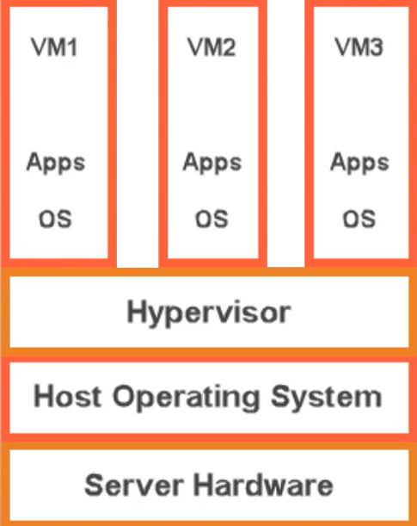
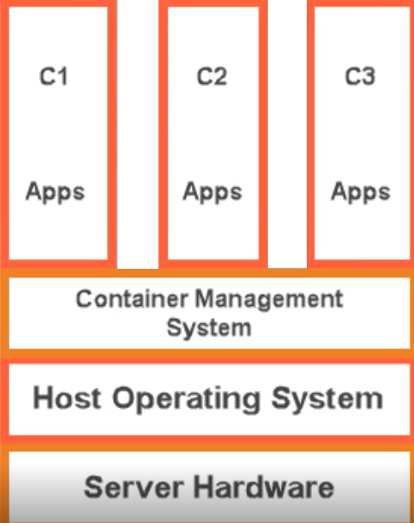
Overview of Containers

Slide 4
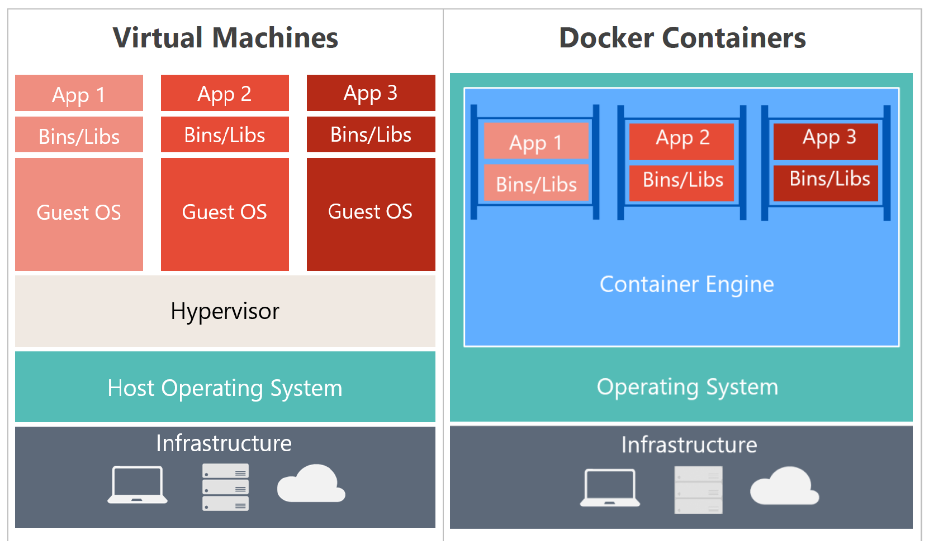
Docker vs VM

Slide 5
Docker in Windows

Slide 6
Docker in Windows

Slide 7
Docker Containers and Development
Docker is a software containerization platform with a common toolset, packaging model, and deployment mechanism
Docker greatly simplifies containerization and distribution of applications that can be run anywhere
A Docker image can be created that will deploy identically across any environment in seconds
DockerHub has more than 180,000 applications in the public community repository
Docker organized the Open Container Initiative (OCI)

Slide 8
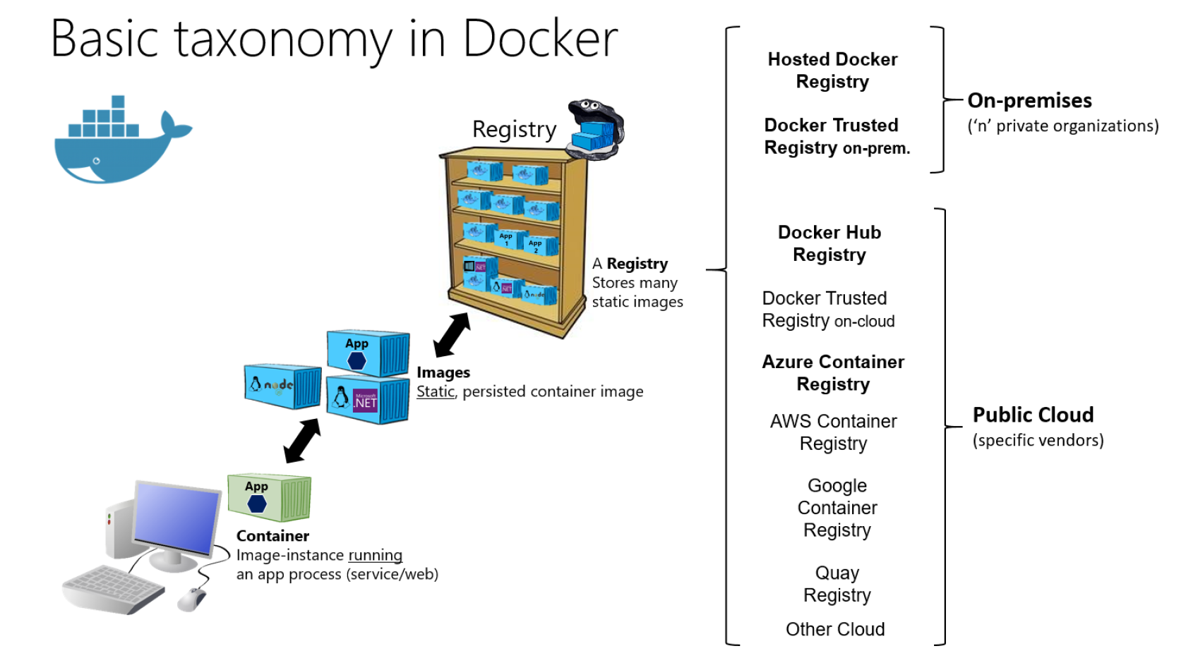
Docker Containers and Development

Slide 9
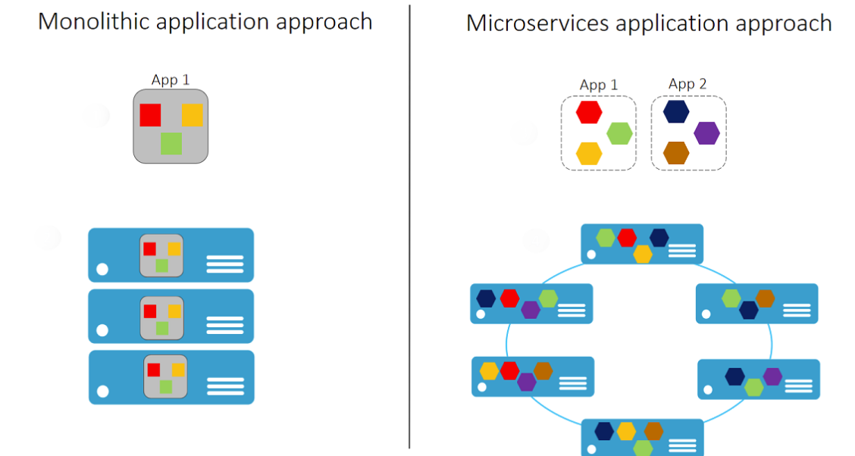
Microservices and Containers
✔️ With Microservices every part of the application is deployed as a fully self-contained component

Slide 10
Azure Container Related Services
Azure Container Instances let you focus on creating your applications rather than provisioning and management of the infrastructure
Azure Kubernetes Service is the de facto standard for container orchestration
Azure Container Registry lets you store and manage container images in a central registry
Azure Service Fabric to build and operate always-on, scalable, distributed apps
Azure App Service provides a managed service for both Windows and Linux based web applications

Slide 11
Dockerfile Core Concepts
FROM ubuntu
LABEL maintainer="greglow@contoso.com"
ADD appsetup /
RUN /bin/bash -c 'source $HOME/.bashrc; \
echo $HOME'
CMD ["echo", "Hello World from within the container"]
✔️ Dockerfiles are text files that contain the commands needed by docker build to assemble an image

Slide 12
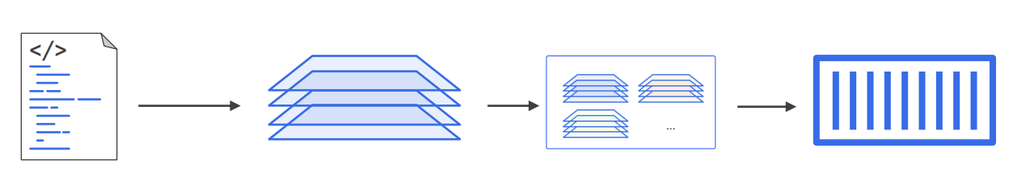
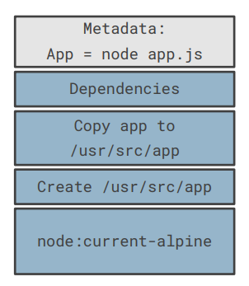
Dockerfile Core Concepts

Slide 13
Naming an image
<docker-hub-id>/<repo-name>:<version>

Slide 14
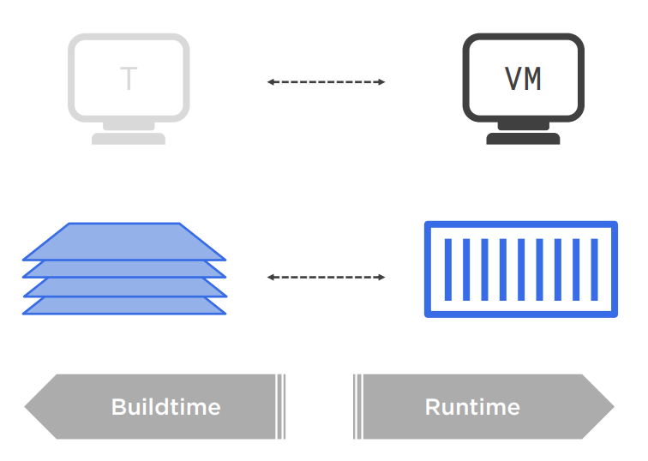
Running an image

Slide 15
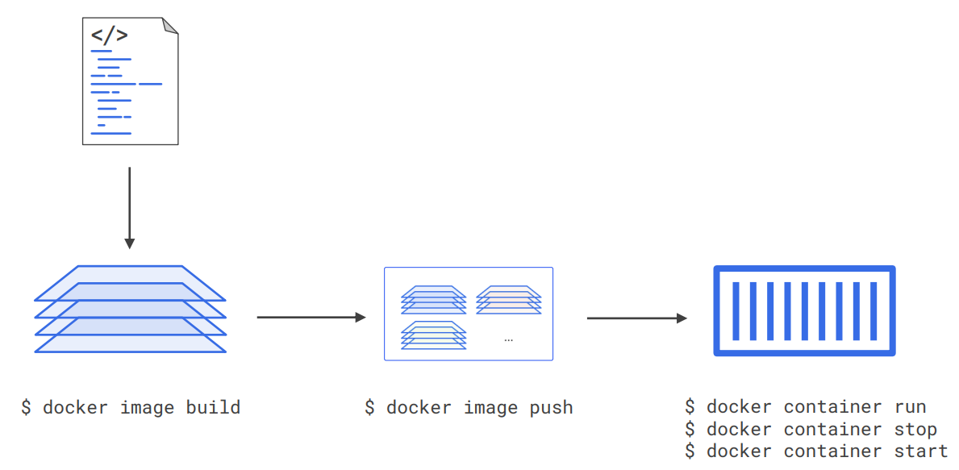
Workflow

Slide 16
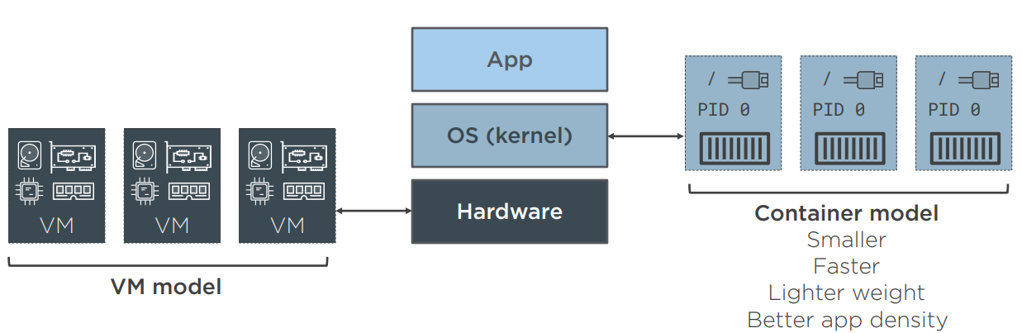
Workflow

Slide 17
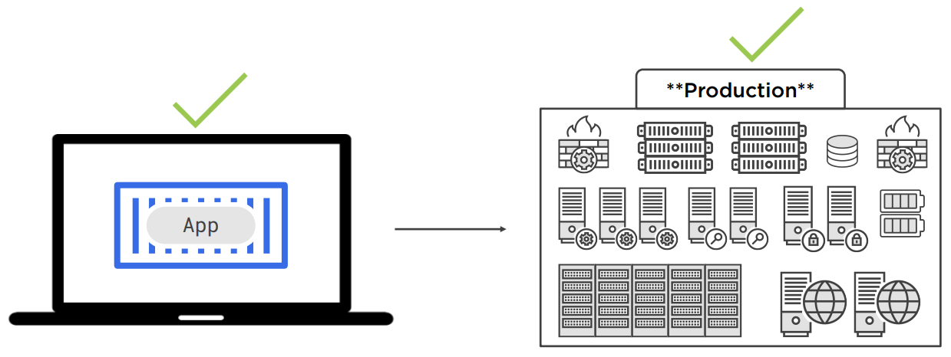
Workflow

Slide 18
Multiple Stage Builds
Keep the image size as small as possible
Layers are additional instructions added to the Dockerfile
Multi-stage builds helps optimize the files, improves their readability, and makes them easier to maintain
Each FROM instruction starts a new stage
The stages are numbered in order, starting with stage 0
Stages are named using an AS clause
Naming stages lets you build them separately

Slide 19
Considerations for Multiple Stage Builds
Adopt Container Modularity
Avoid Unnecessary Packages
Choose an Appropriate Base
Avoid Including Application Data

Slide 20
Docker Networking

Slide 21
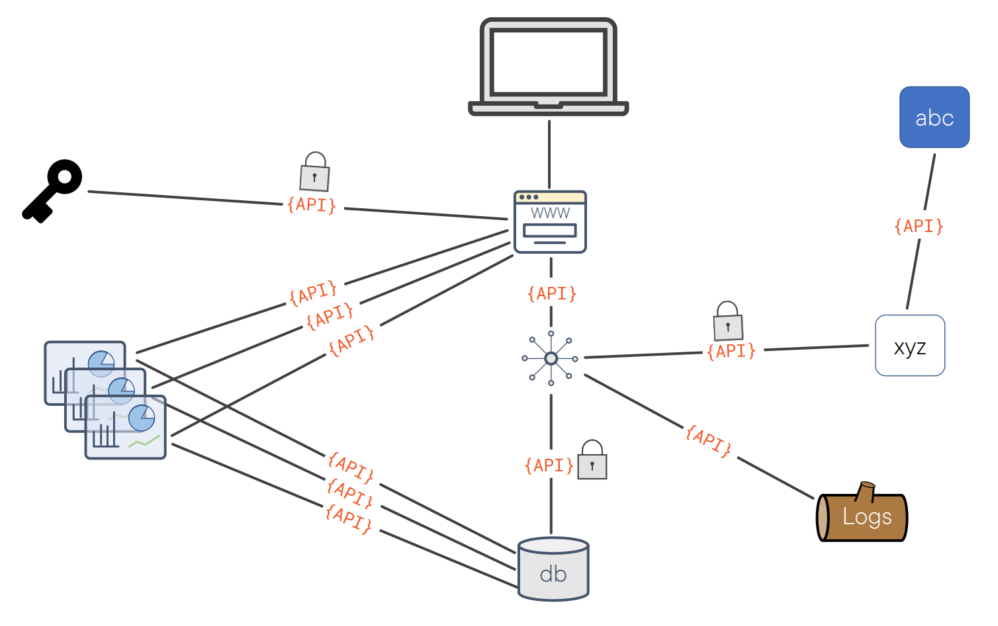
Docker Networking

Slide 22
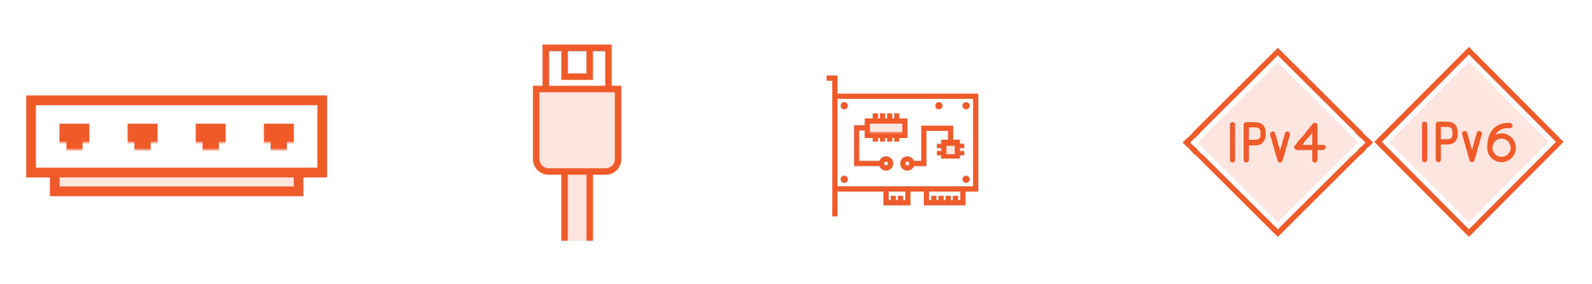
Container Networks
Built from standard networking components

Slide 23
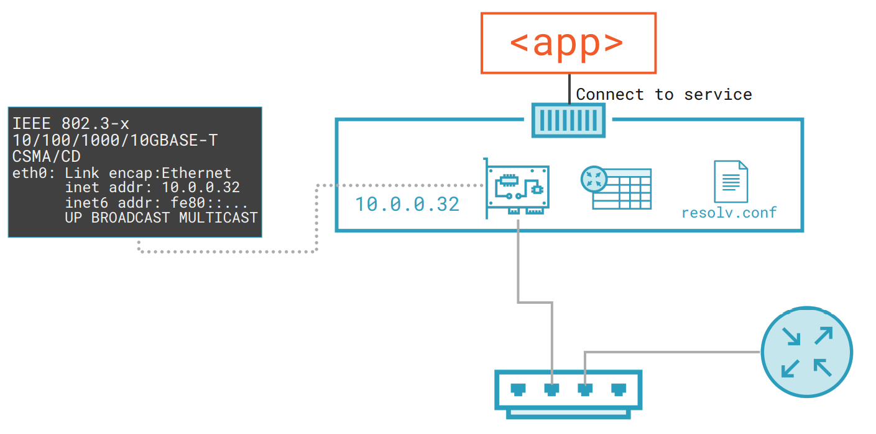
Container Networks
Built from standard networking components

Slide 24
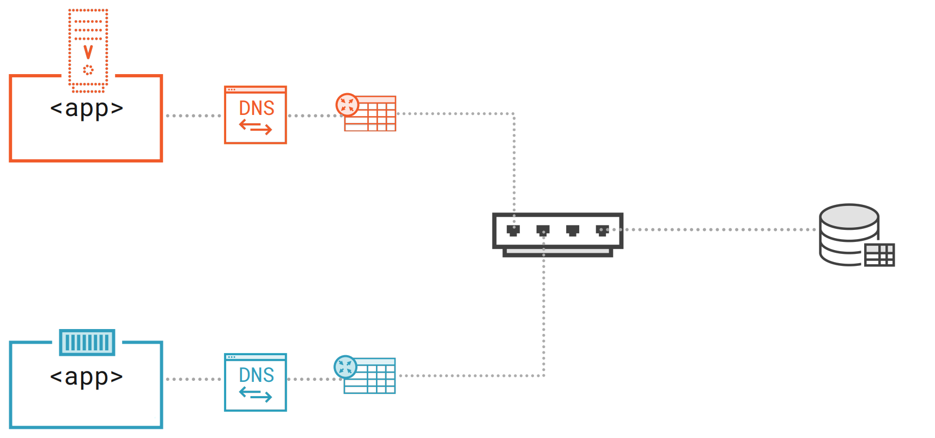
Container Networks

Slide 25
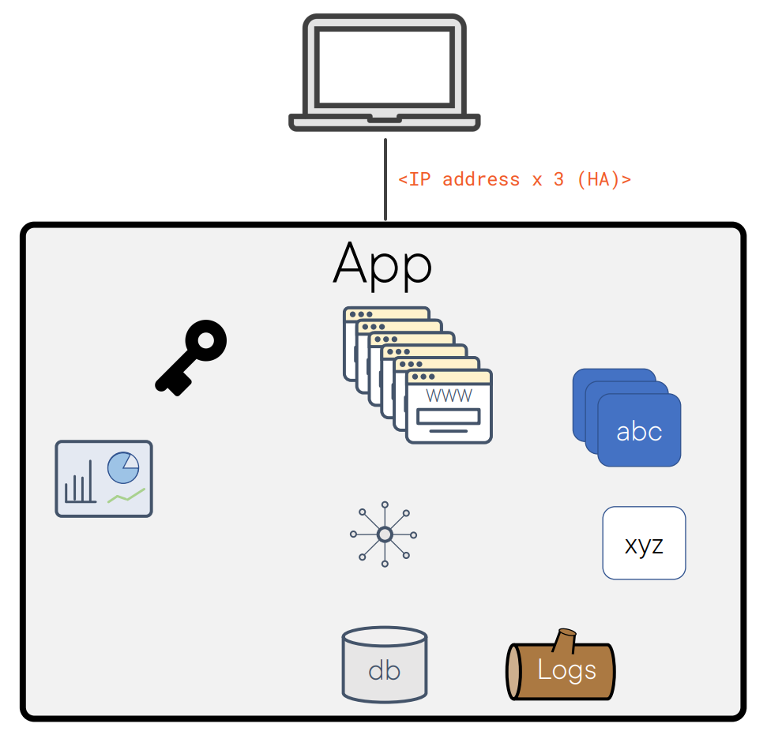
Container Networks

Slide 26
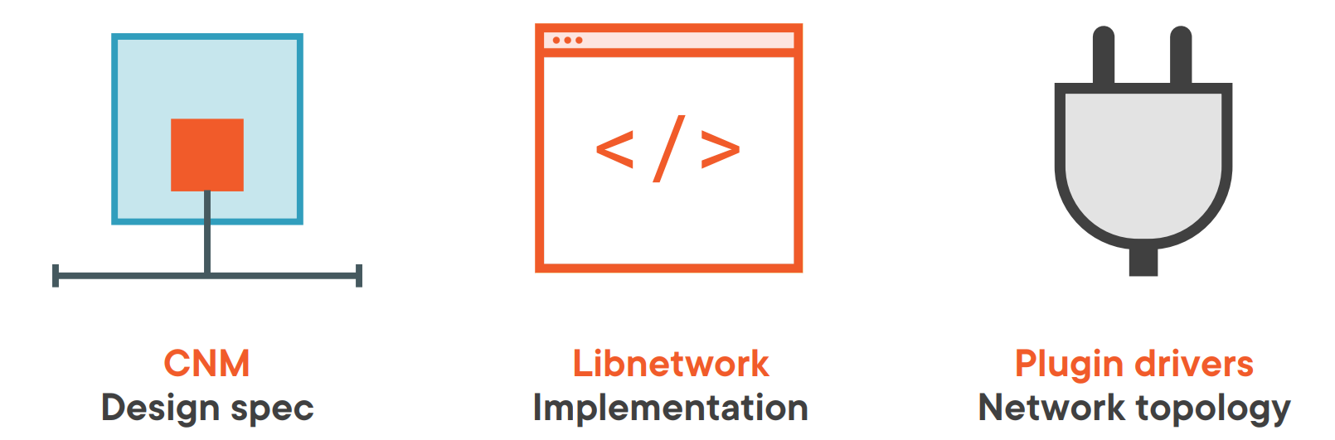
Container Networks

Slide 27
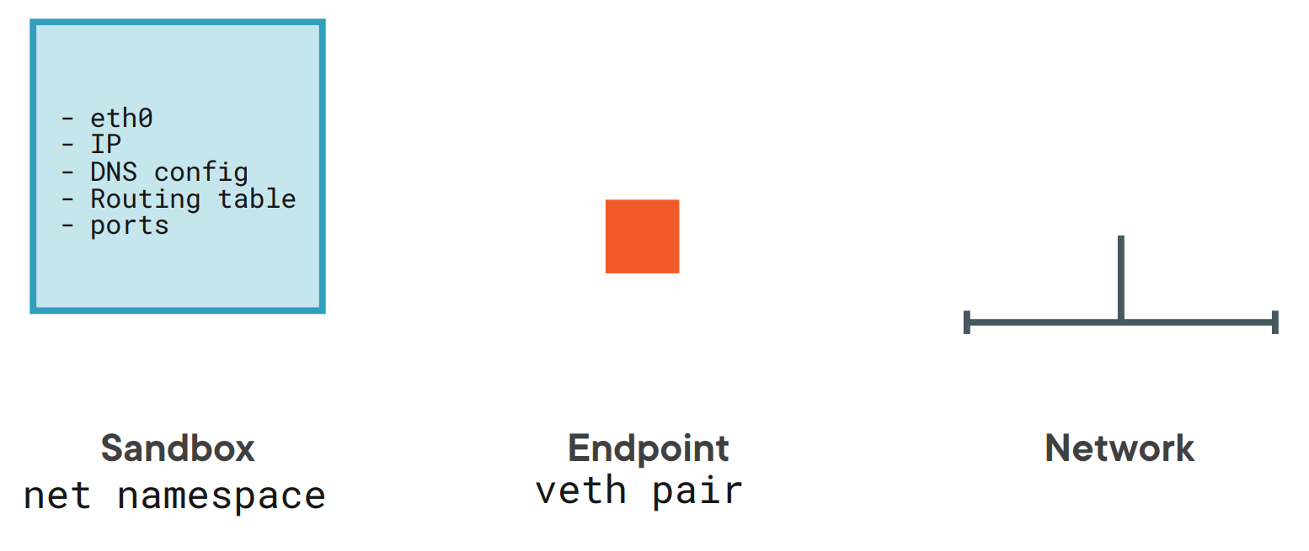
Container Network Model

Slide 28
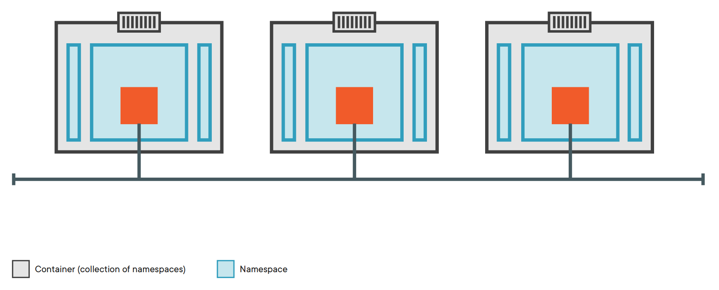
CNM + Endpoint

Slide 29
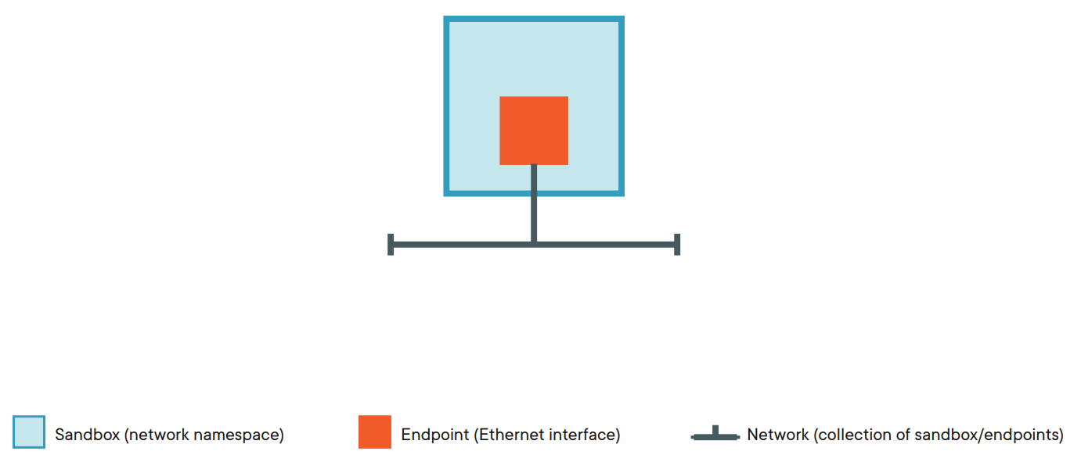
Container Network Model (CNM)

Slide 30
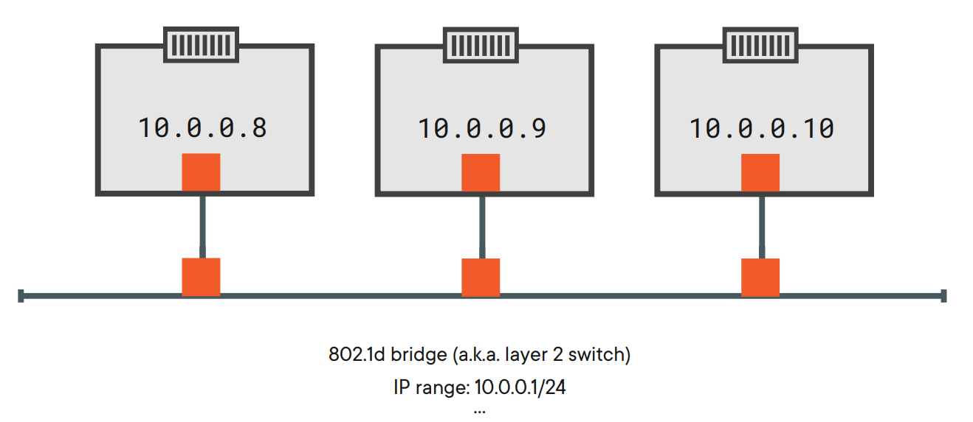
Implementation

Slide 31
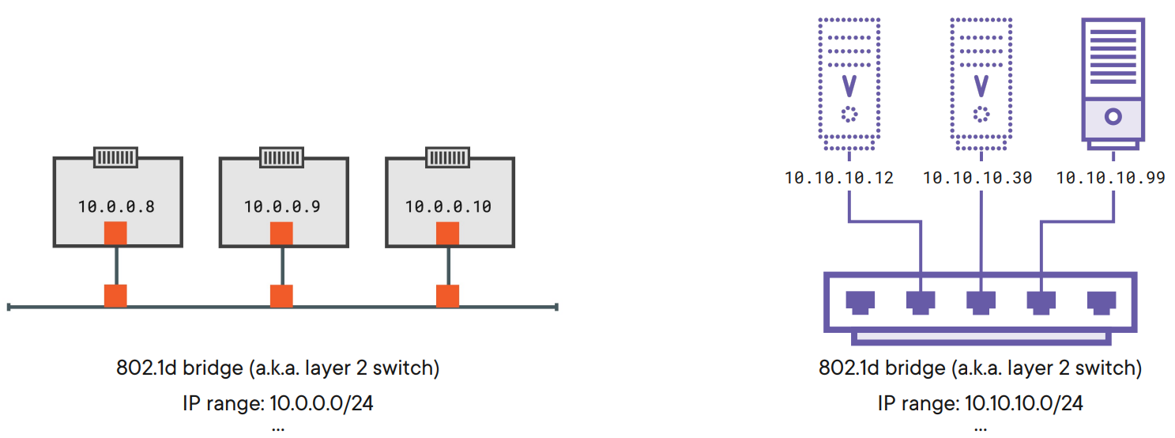
Implementation

Slide 32
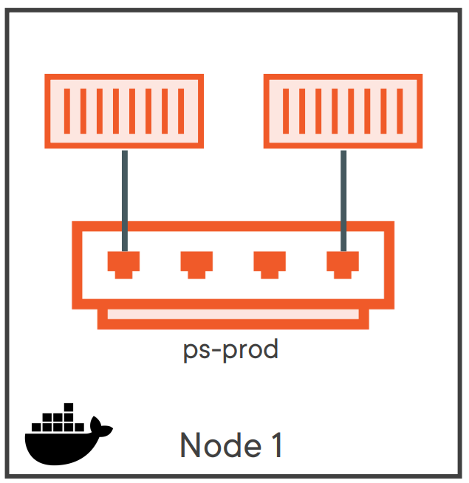
Single-host Bridge Networks

Slide 33
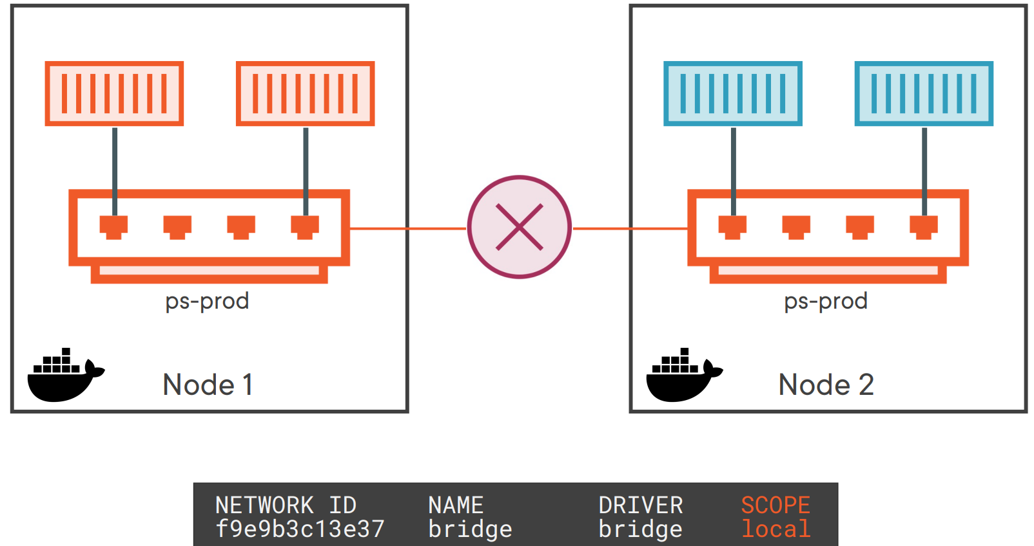
Single-host Bridge Networks

Slide 34
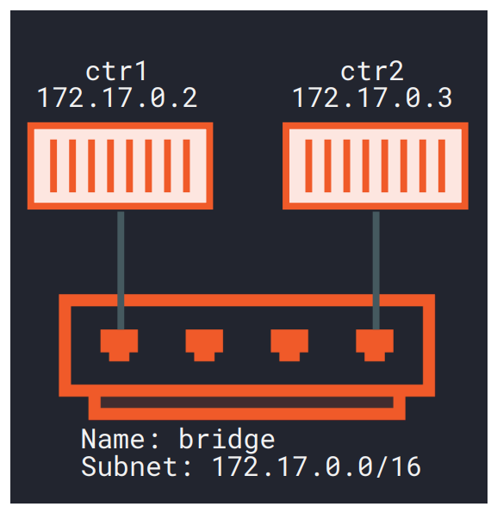
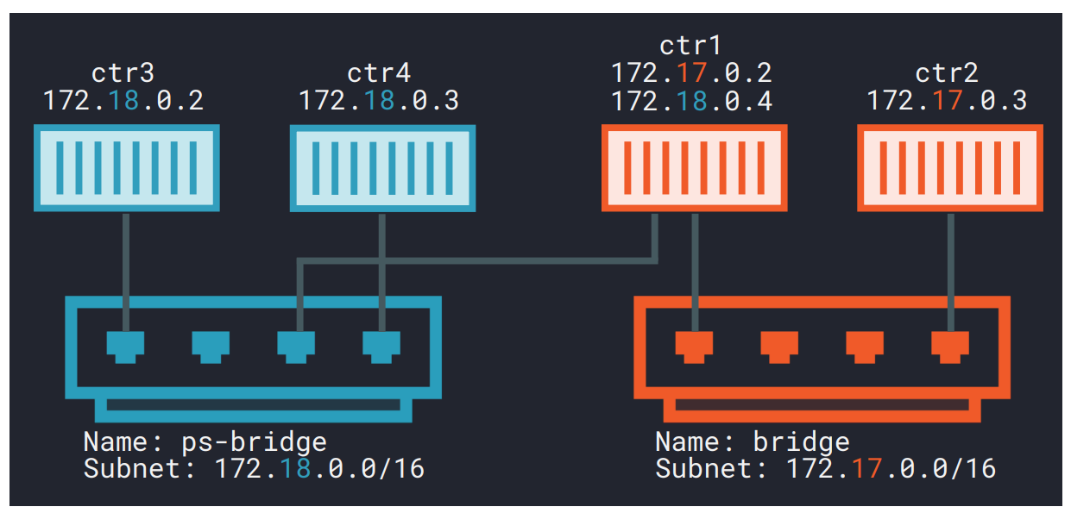
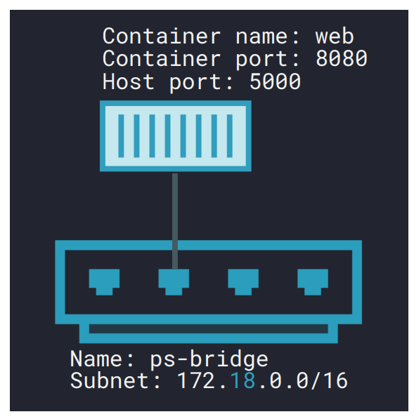
Single-host Bridge Networks

Slide 35
Hands-on Docker

Slide 36
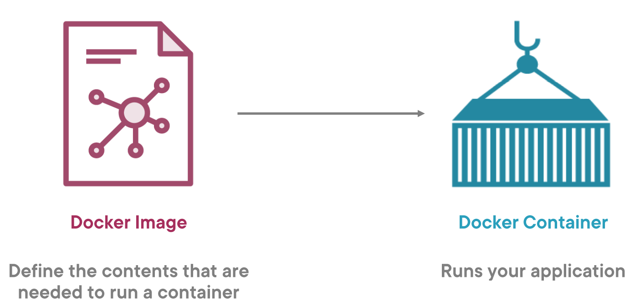
Images and containers

Slide 37
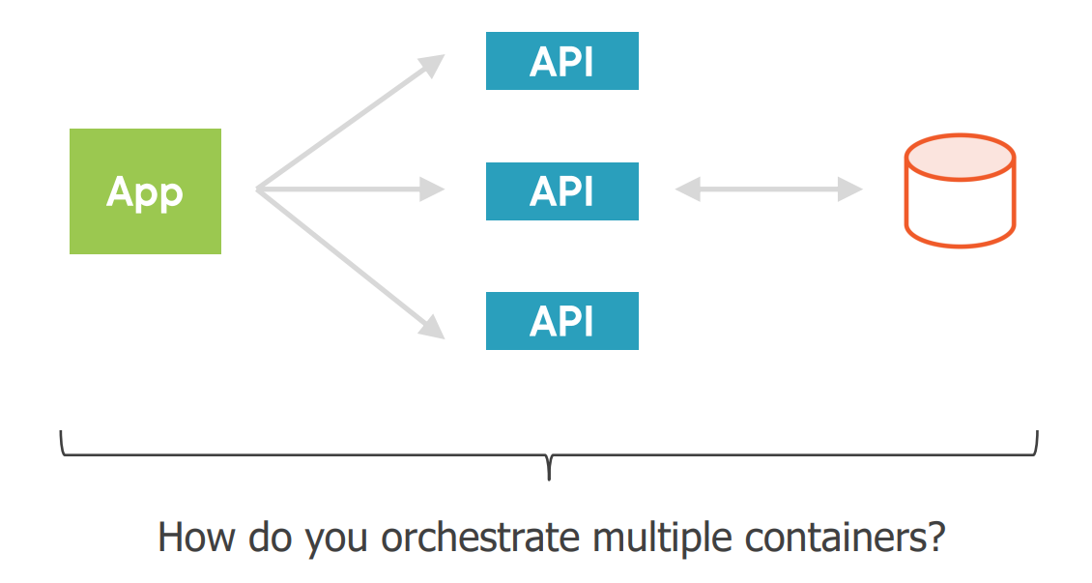
Communicating between containers

Slide 38
Build & Run an image
docker build –t <docker-hub-id>/<image-name>:<version> .
docker run –p 8080:80 <image-name>:<version>

Slide 39
A first application
DEMO

Slide 40
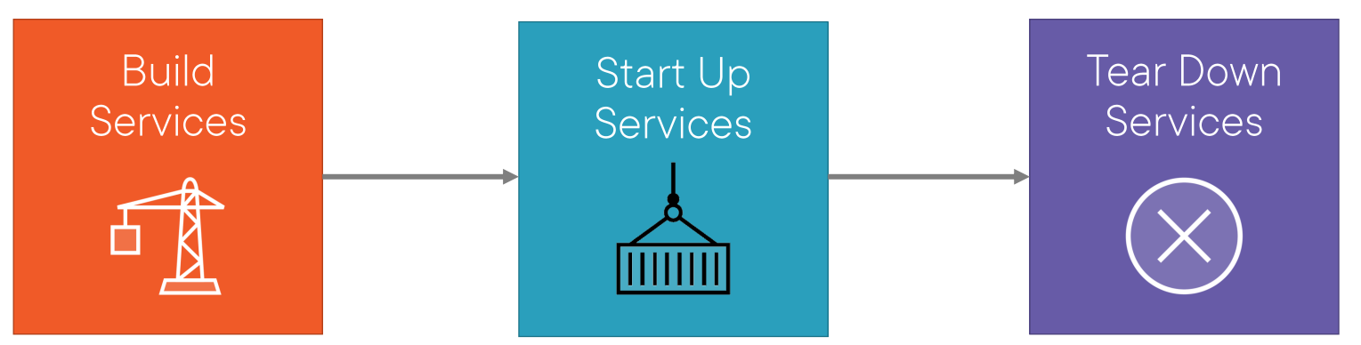
Docker compose workflow

Slide 41
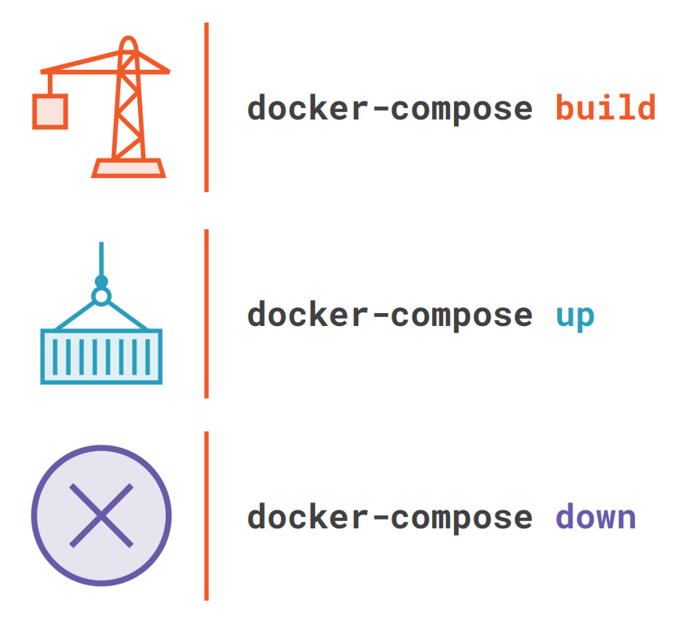
Docker compose commands

Slide 42
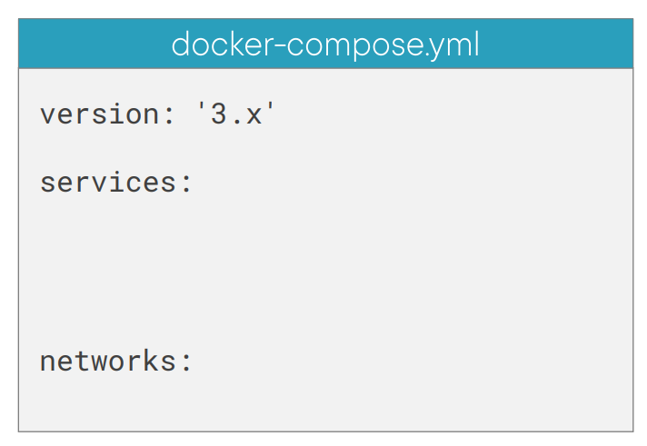
Docker Compose: Services

Slide 43
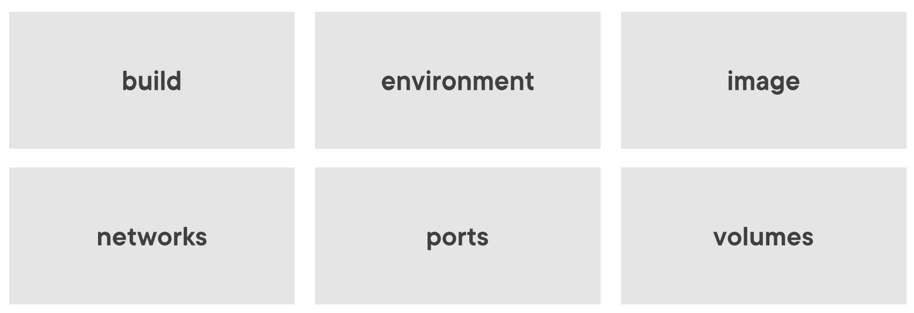
Key Service Configuration Options

Slide 44
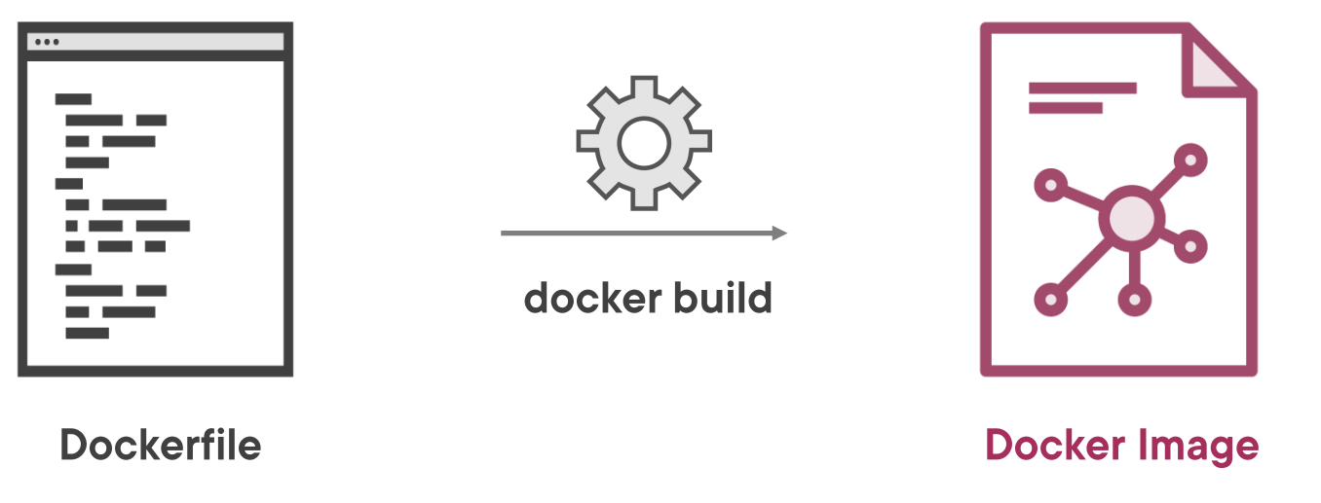
Dockerfile and Images

Slide 45
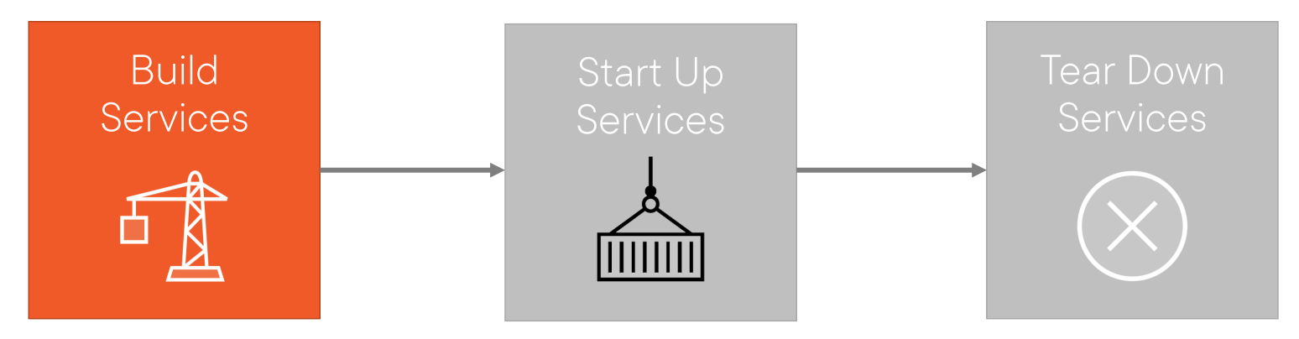
Docker Compose Workflow

Slide 46
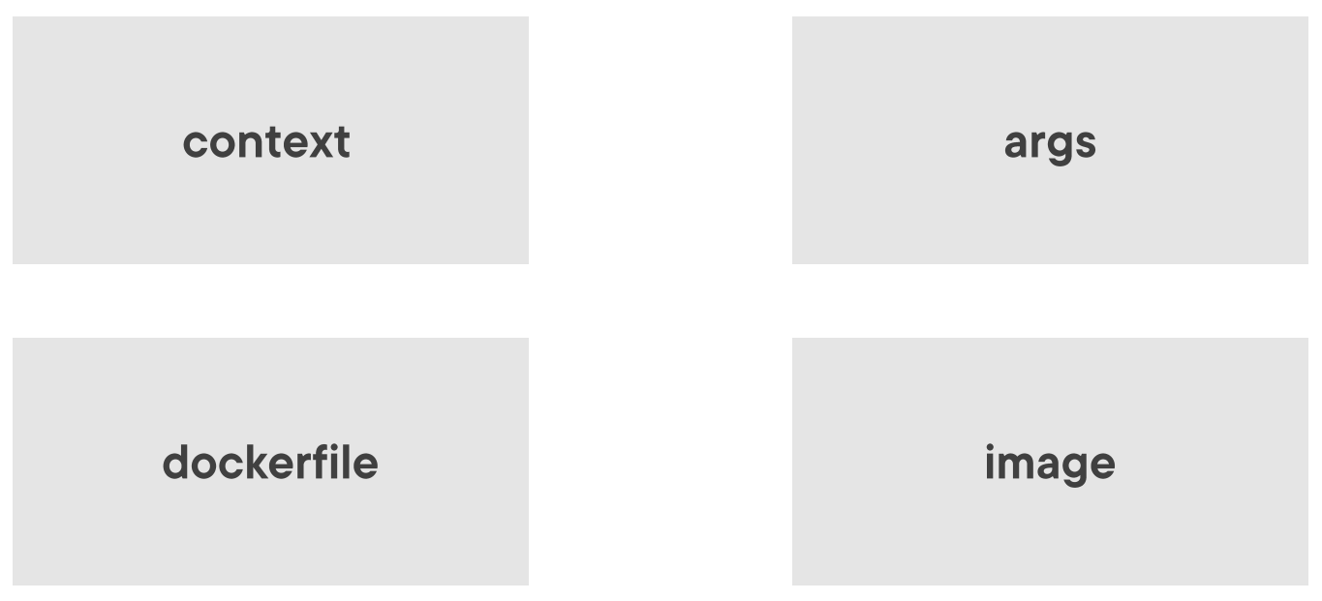
Key Docker Compose Build Properties

Slide 47
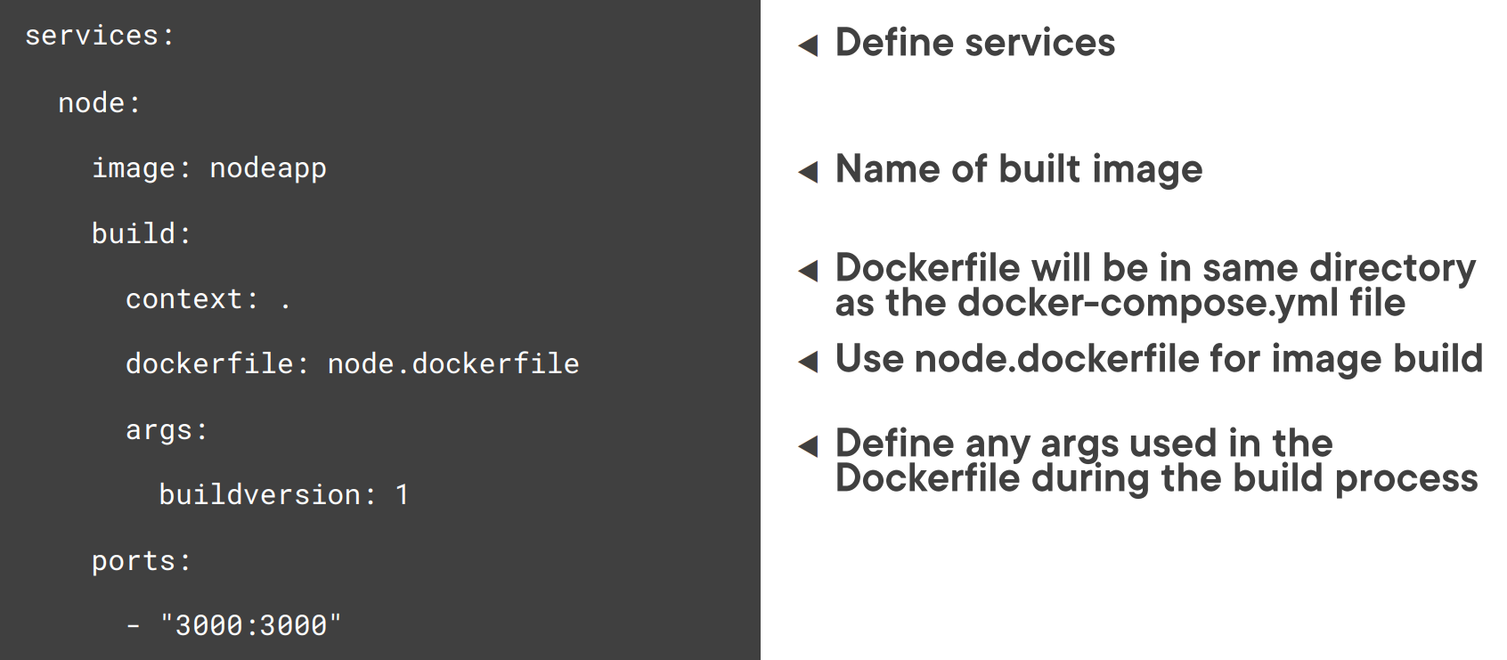
Using Docker Compose Build Properties

Slide 48
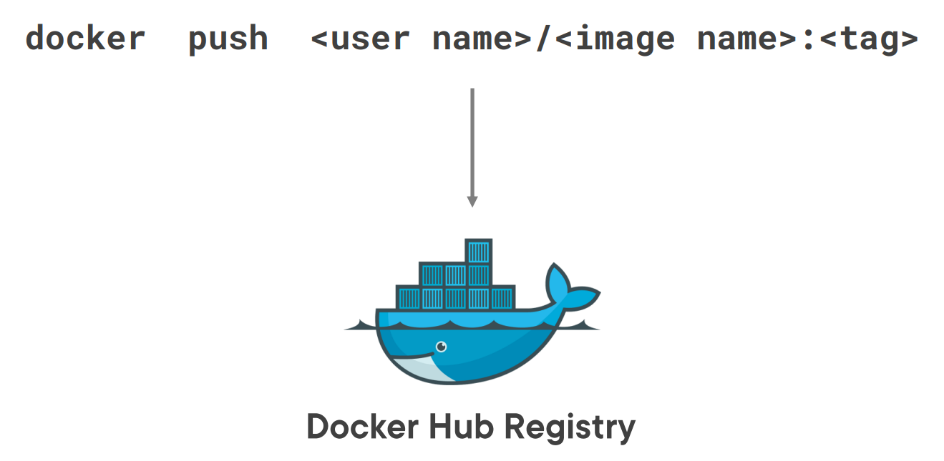
Push an Image to Docker Hub

Slide 49
Push an Image to Docker Hub
docker-compose push

Slide 50
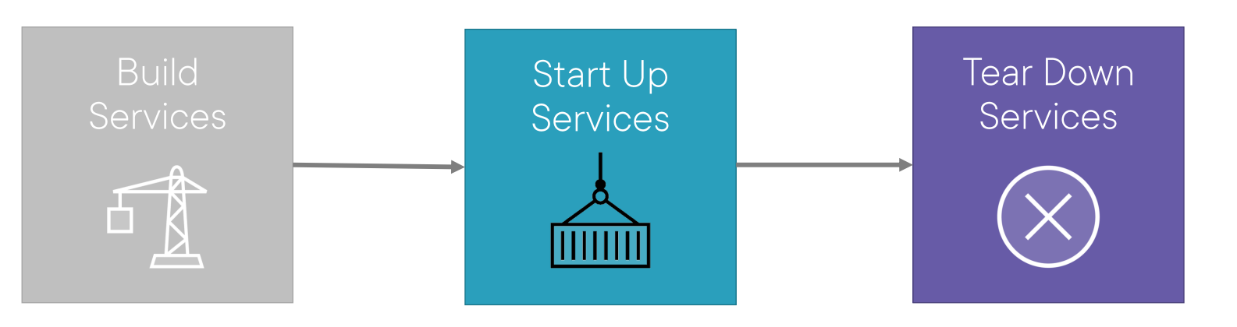
Docker Compose Workflow

Slide 51
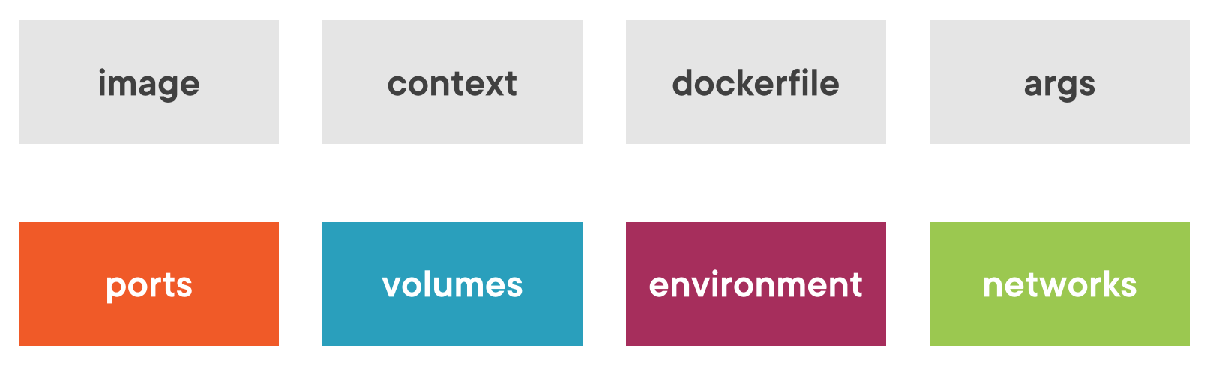
Docker Compose Container Properties

Slide 52
Running a container and defining ports

Slide 53
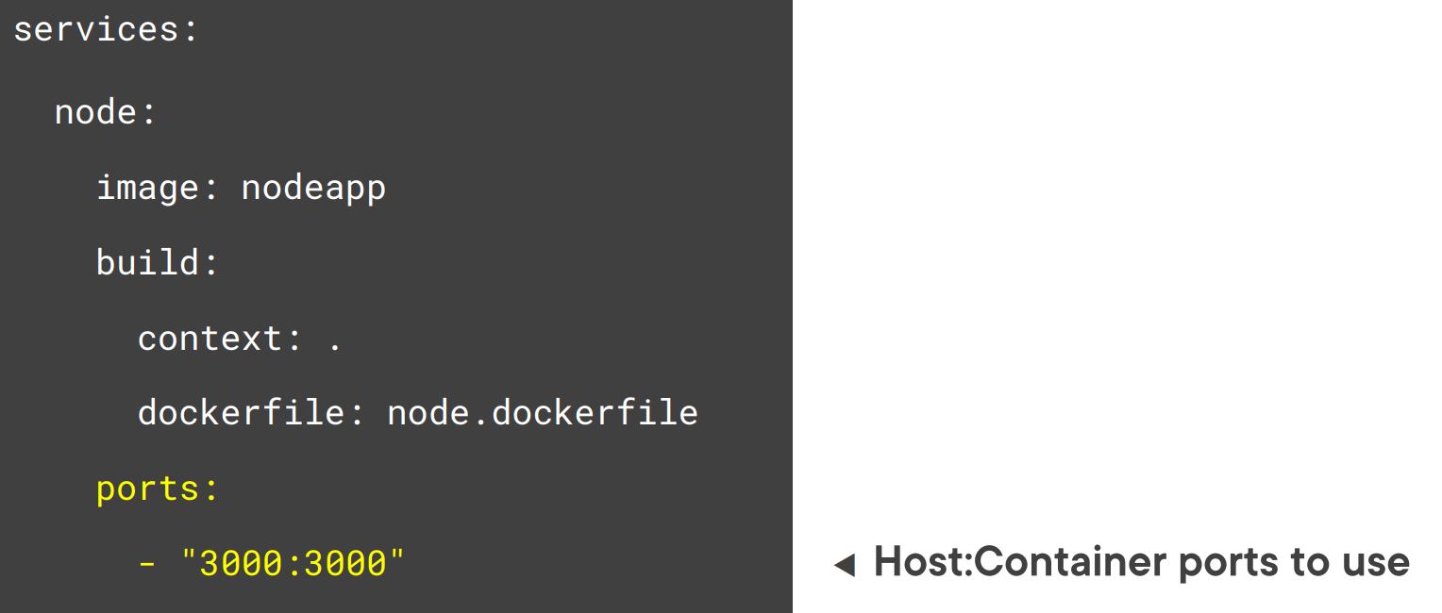
Defining Ports

Slide 54
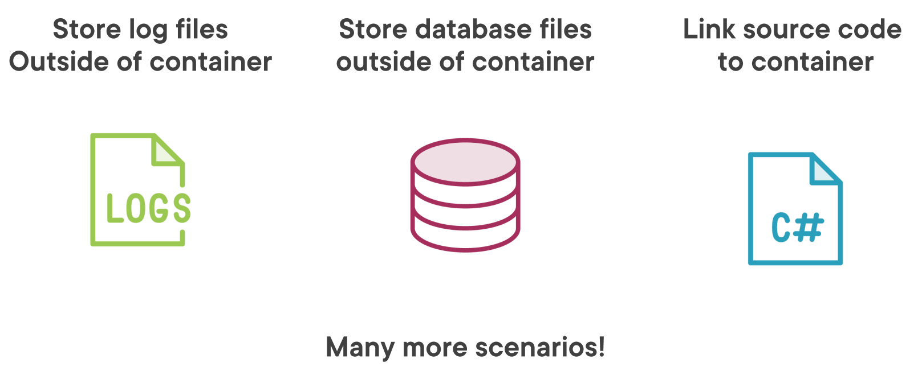
Volume usage scenarios

Slide 55
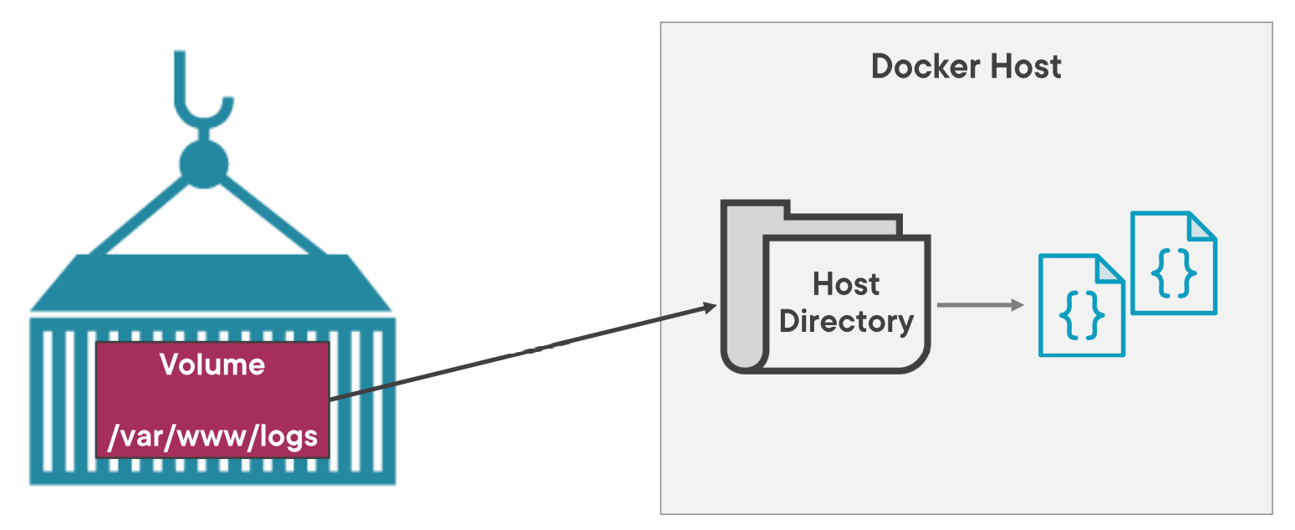
Volume mounts

Slide 56
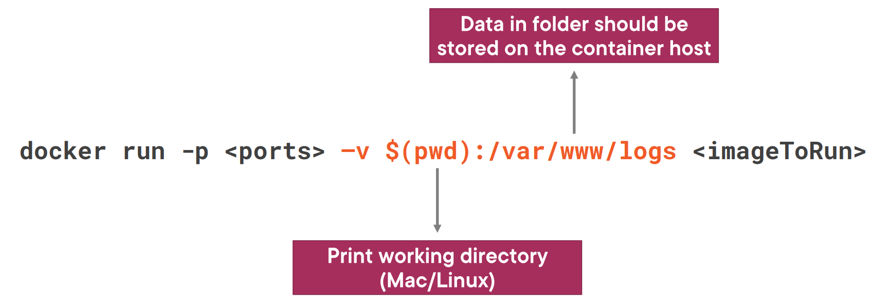
Defining a Host location (Mac/Linux)

Slide 57
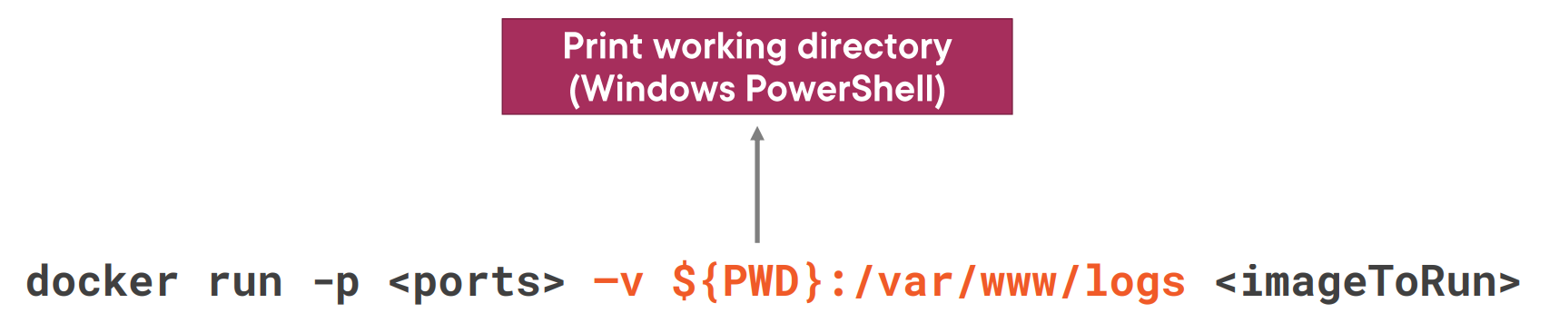
Defining a Host Location (Powershell)

Slide 58
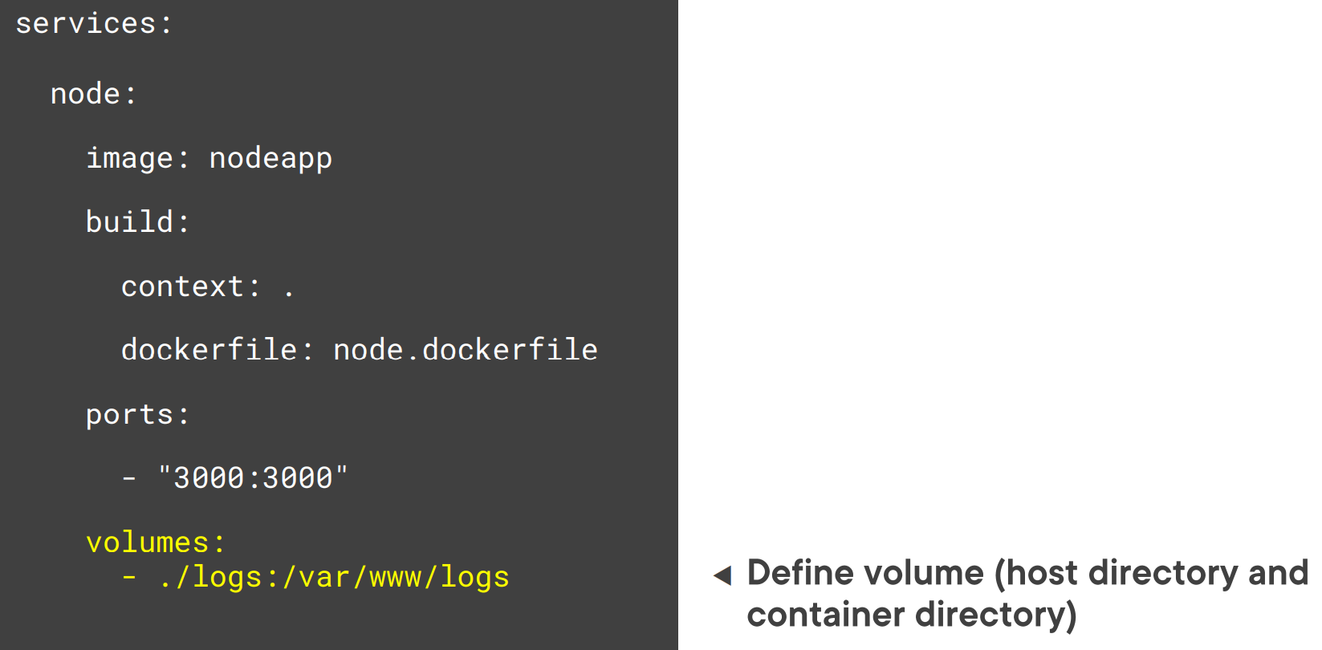
Defining Volumes

Slide 59
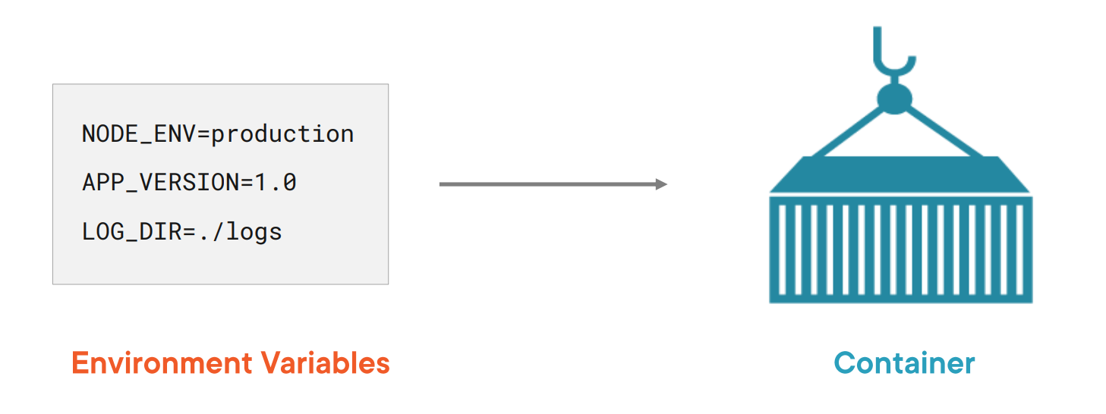
Environment Variables and Containers

Slide 60
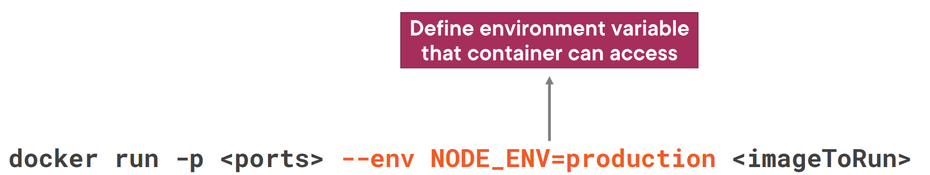
Defining an Environment Variable

Slide 61
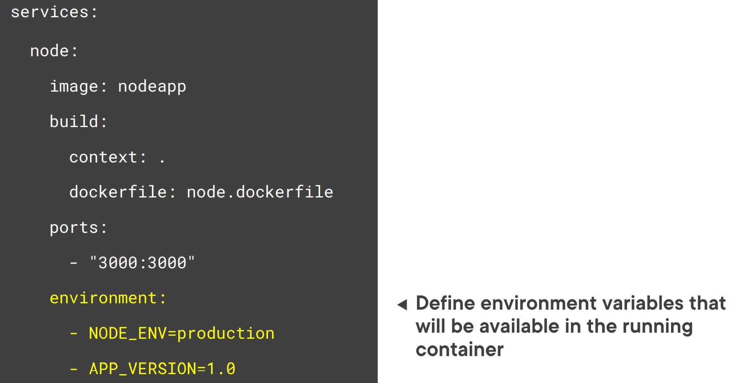
Defining Environment Variables

Slide 62
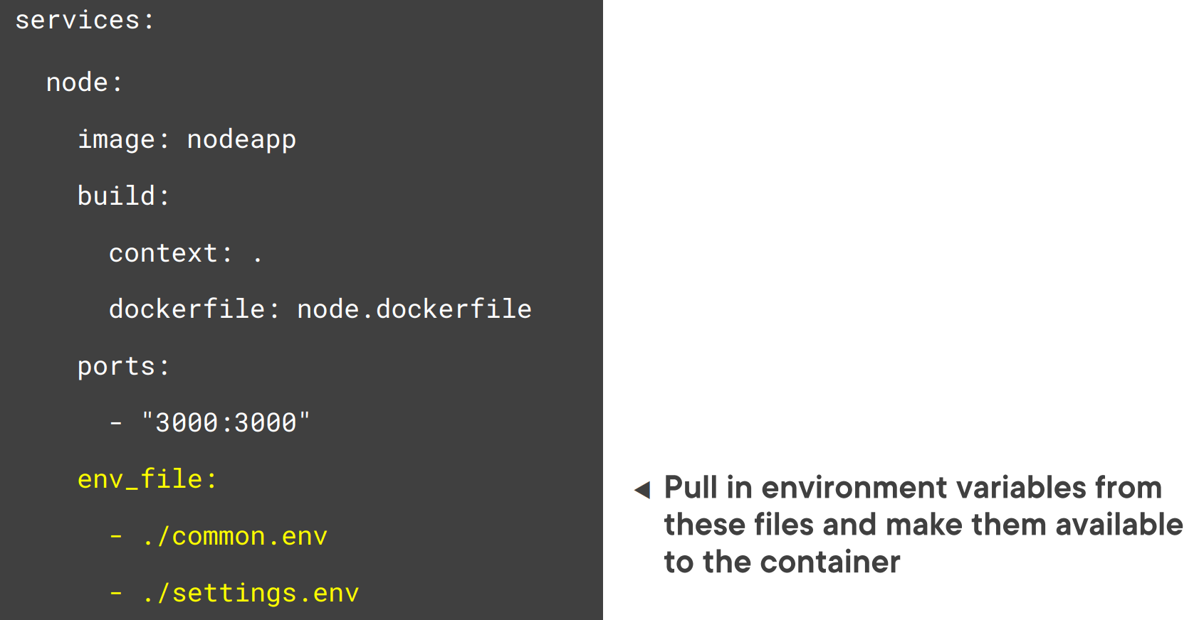
Defining Environment Variables in a File

Slide 63

Define a Bridge Network

Slide 64

Defining Dependencies

Slide 65


Creating and starting containers

Slide 66




View Container Logs

Slide 67

Shell into a container

Slide 68

Shell into a container (compose)

Slide 69

Scaling containers

Slide 70

Defining an Environment Variable

Slide 71

Service Ports and Scaling

Slide 72

Service Ports and Scaling

Slide 73

Defining Deployment Replicas and Restart Policies

